Slide 1

Crypto Currency Dashboard
- Mohit Mande

Slide 2

Introduction & Overview
The cryptocurrency dashboard project involves creating an interactive visualization tool using Streamlit, Seaborn, and other libraries in Python.
The goal is to provide users with a dynamic interface to explore and analyze cryptocurrency data, including metrics like price changes, rolling averages, volume, correlation, and more.
The project aims to leverage Streamlit for the web app, Altair for interactive visualizations, and various other Python libraries for data manipulation and analysis.
Users can select different cryptocurrencies, visualize specific metrics, and interact with the plots for a comprehensive understanding of cryptocurrency trends.

Slide 3
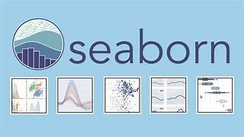
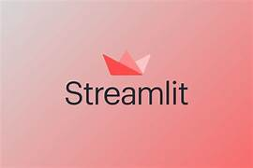
Technologies used
Streamlit: Streamlit is the main framework used to create the web application
Pandas: Pandas is a powerful data manipulation library in Python
Matplotlib: Matplotlib is a popular plotting library in Python.
Seaborn: Seaborn is a high-level interface for drawing attractive and informative statistical graphics.
Altair: It is used to create interactive charts and visualizations.
NumPy: used for numerical operations and array manipulation.

Slide 4
Methodology:
Data Collection
Data Cleaning and Preprocessing
Data Exploration
Visualization Development

Slide 5
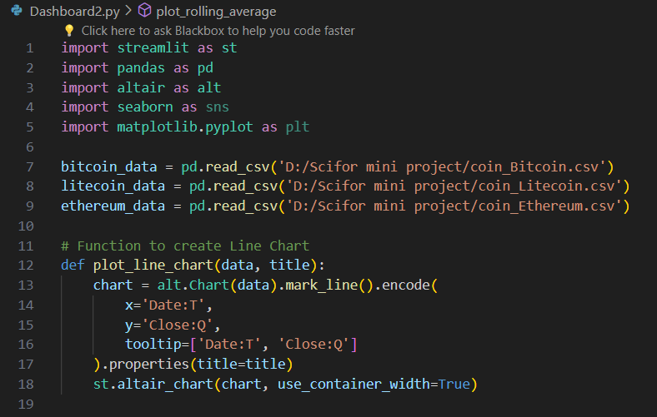
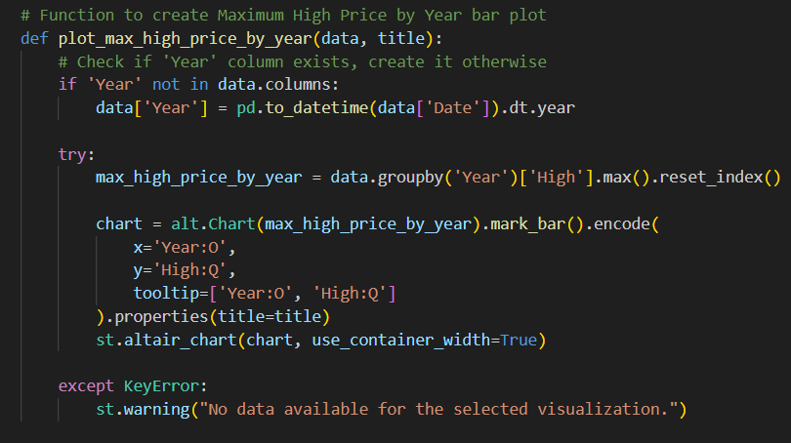
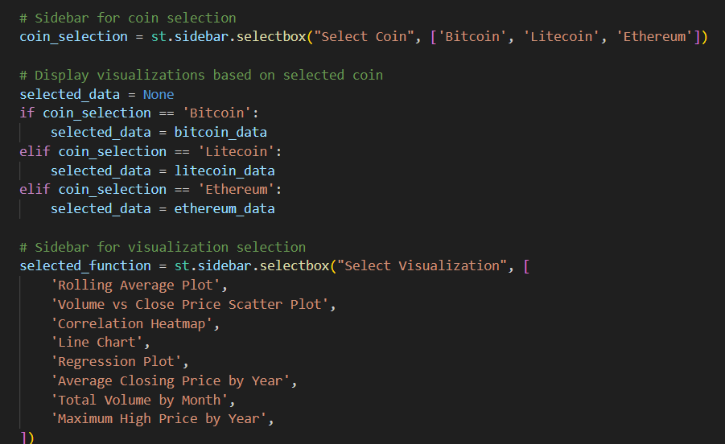
Code

Slide 6
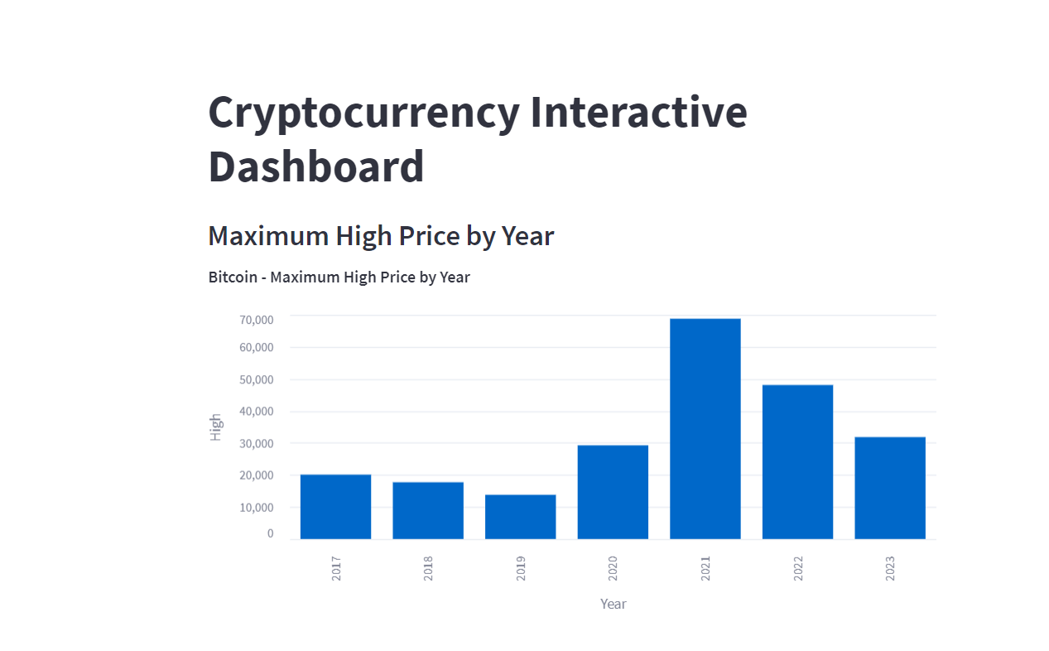
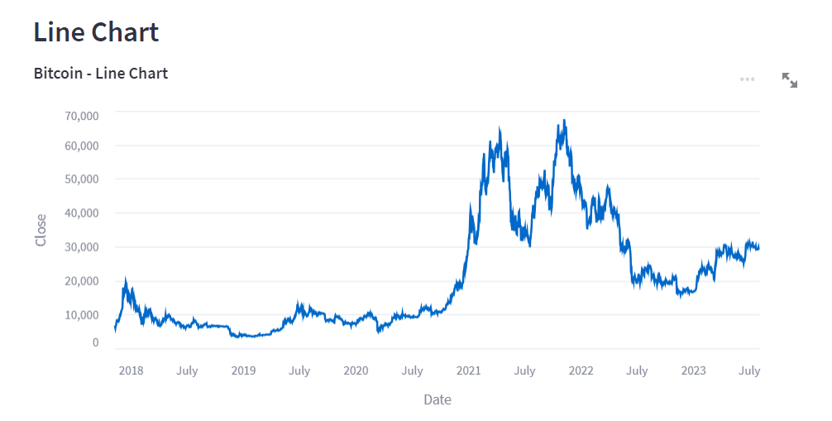
Results

